Slide 1
SQL To Workflow Converter
Converting declarative SQL queries into executable visual workflows using logical plans

Slide 2
Introduction
SQL is a widely used declarative language for querying and analyzing data
Visual workflow systems like Texera model analytics as operator-based pipelines
SQL specifies what result is required, while workflows define how the result is produced
Bridging these two paradigms enables SQL users to leverage visual analytics systems
This project focuses on automatically converting SQL queries into equivalent Texera workflows

Slide 3
Motivation
1. Education & Accessibility
SQL and workflow systems often require expert knowledge; beginners struggle to translate queries into executable workflows.
By converting SQL → Texera workflows automatically, users can visualize query execution, understand data flow, and learn database concepts interactively.
Impact: Makes database operations and analytics transparent and approachable, promoting hands-on learning.
2. Collaboration & Extensibility
Generated workflows provide a shared, visual artifact that teams can inspect, modify, and extend.
Enables cross-language augmentation: Python UDFs, custom analytics, or integration with other operators can be layered on top of the SQL-generated workflow.
Impact: Teams can collaboratively experiment, combine SQL logic with other computational tools, and scale analysis across heterogeneous datasets.

Slide 4
Problem Statement
1. Hybrid Metadata Inference for CSVs
CSVs lack schema/type guarantees → unlike DBMS tables.
Handle missing headers, type mismatches, and malformed rows.
Impact: Accurate operator mapping and system compatibility.
2. Operator Mapping from SQL to Texera Workflow
Map SQL logical operators → workflow operators (filters, joins, aggregates, projections).
Recursive traversal ensures correctness and reproducibility.
Impact: Users can “compile” SQL queries into visual, executable workflows.
3. Logical Plan–Aware Optimization
Naive workflow generation produces redundant operators & late filters, increasing runtime and memory.
Solution: Push down filters/projections, reorder joins heuristically, reduce intermediate data.
Impact: More efficient workflows without needing full physical cost modeling, improving performance across diverse CSV datasets

Slide 5
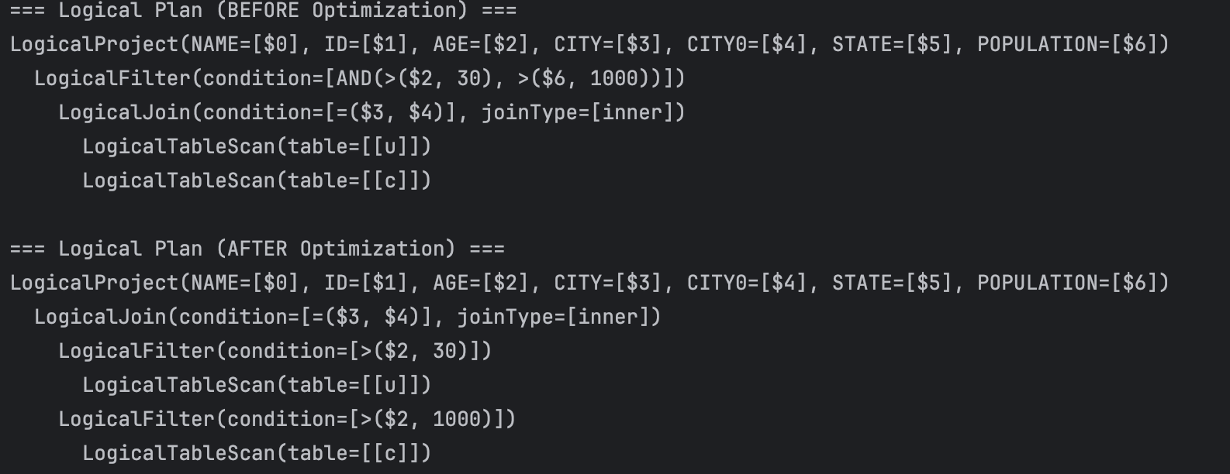
Elaboration on Logical Plan Optimization

Slide 6
Elaboration on Logical Plan Optimization
Pushing filters below joins is essential for both efficiency and correctness in workflow-based systems.
While relational databases implicitly reorder operators, workflow engines execute operators in a fixed, user-defined order.
Without logical plan optimization, relation-specific predicates can only be evaluated after the join, leading to large intermediate results and unnecessary computation.
By analyzing the logical plan, our system decomposes predicates and applies them to the appropriate inputs before the join, producing workflows that are both semantically faithful to SQL and significantly more efficient.

Slide 7
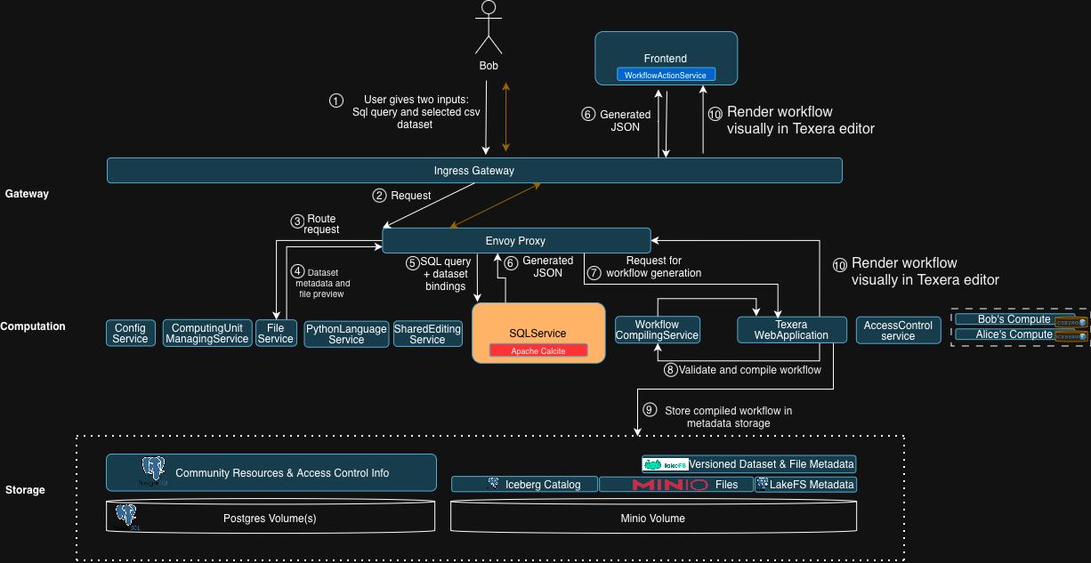
Architecture diagram

Slide 8
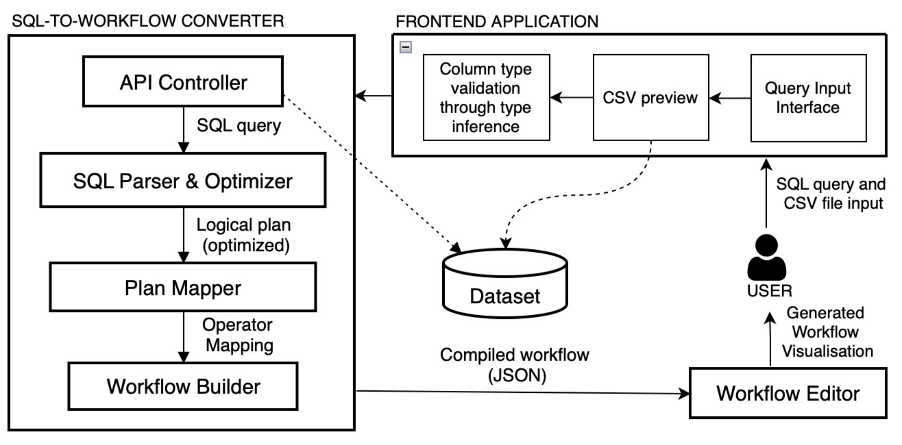
SQL Service diagram

Slide 9
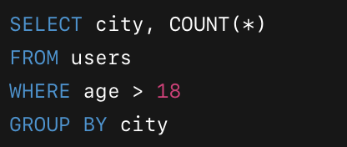
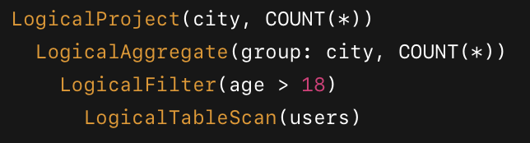
Parsing SQL Query to Logical Plan
Direct SQL parsing is insufficient to determine correct execution order
Logical plans explicitly represent operators and their dependencies
Using logical plans allows the system to preserve SQL semantics and handle complex queries in a structured manner
Apache Calcite is used as the SQL parser and optimizer to generate validated logical plans
Leveraging Calcite avoids implementing a custom SQL parser and ensures standards-compliant query handling
Logical plans serve as a reliable intermediate representation for workflow generation
The optimizer ensures SQL queries are represented in a form that can be reliably mapped to workflow operators.

Slide 10
Operator Mapping
Each relational operator in the logical plan is mapped to a Texera workflow operator using our custom Texera Converter
Mapping examples:
LogicalTableScan → CSVFileScan
LogicalFilter → Filter
LogicalProject → Projection
LogicalAggregate → Aggregate
LogicalSort → Sort
LogicalJoin → HashJoin
This mapping ensures SQL semantics are preserved and workflow JSON is correctly generated

Slide 11
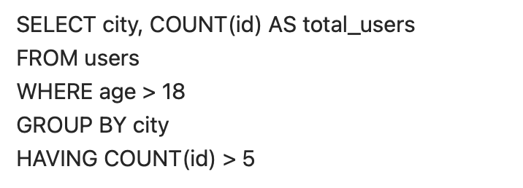
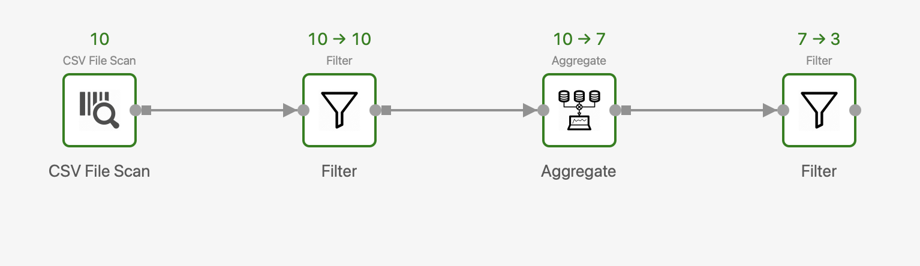
Workflow Construction & Operator Ordering
After mapping, the system traverses the logical plan to determine operator dependencies.
Operators are added to the workflow in execution order
Column name normalization ensures operators reference consistent attributes.
Correct ordering guarantees valid and executable Texera workflow JSON.
This slide shows how SQL queries translate into workflows that are ready for execution with minimal user effort.

Slide 12
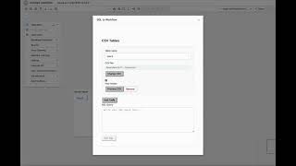
Demonstration

Slide 13
Conclusion
Developed a system that automatically converts SQL queries into Texera workflows
Preserves SQL semantics and handles operator ordering correctly
Enables hybrid type inference or static schema choice for workflow generation
Reduces manual effort in building workflows and lowers the barrier for SQL users
Supports education, collaboration, and reusability in visual analytics
The approach is extensible for more complex queries and future enhancements

